Slide 1

Enhanced
Text to Speech
with
Multi-language Options

Slide 2
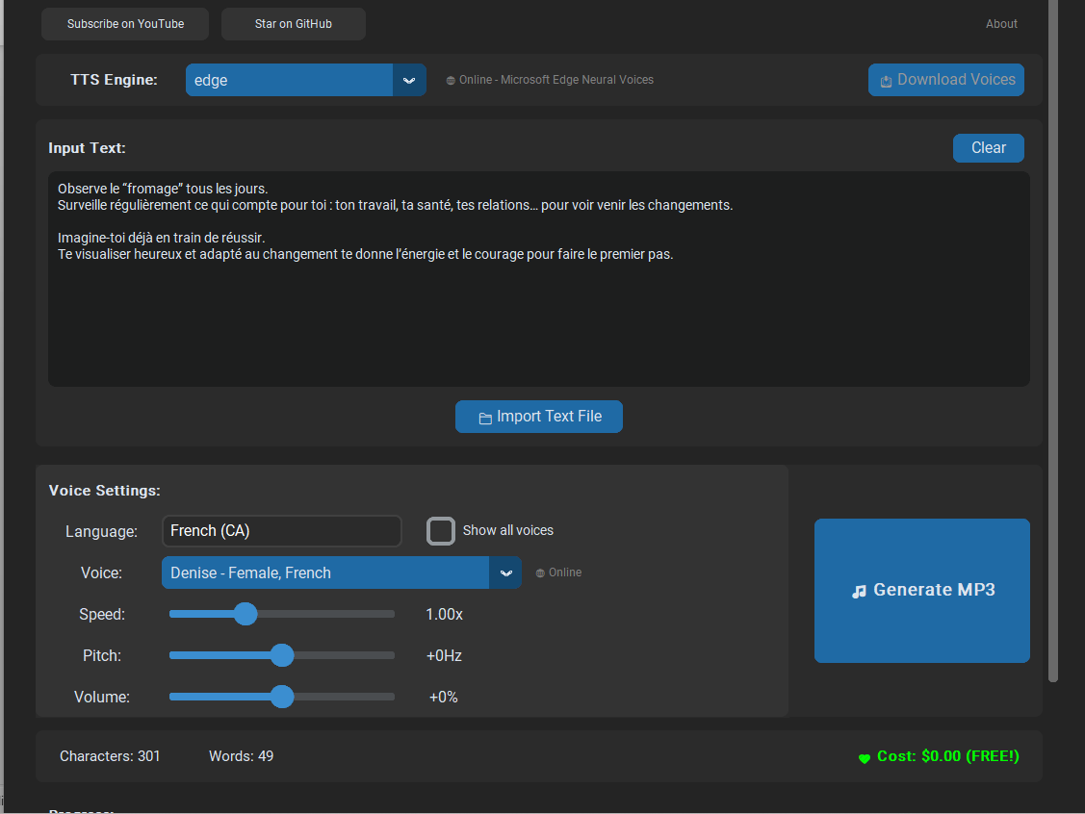
Edge TTS - Step 1
I want to generate French Text to French voice.
Now, enter French text here or import French document
here

Slide 3
Edge TTS - Step 2
Click Here to Choose Language

Slide 4
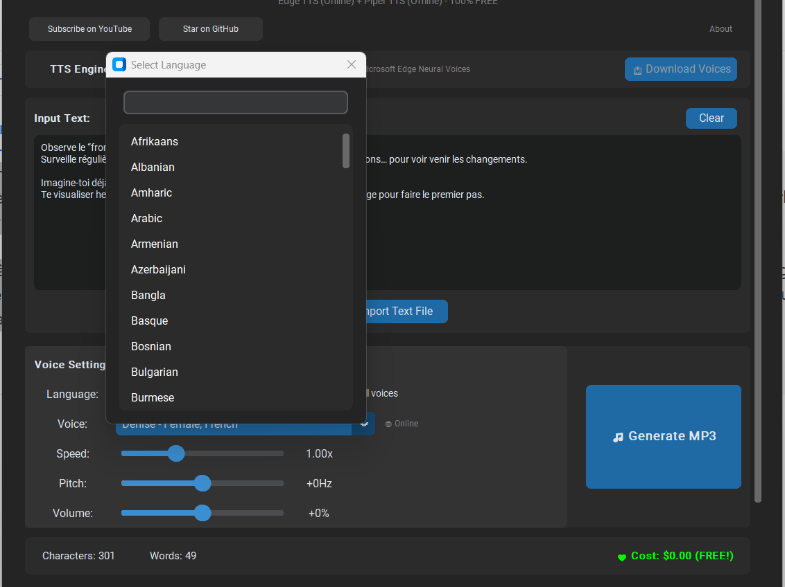
Edge TTS - Step 3
Start typing the language to filter

Slide 5
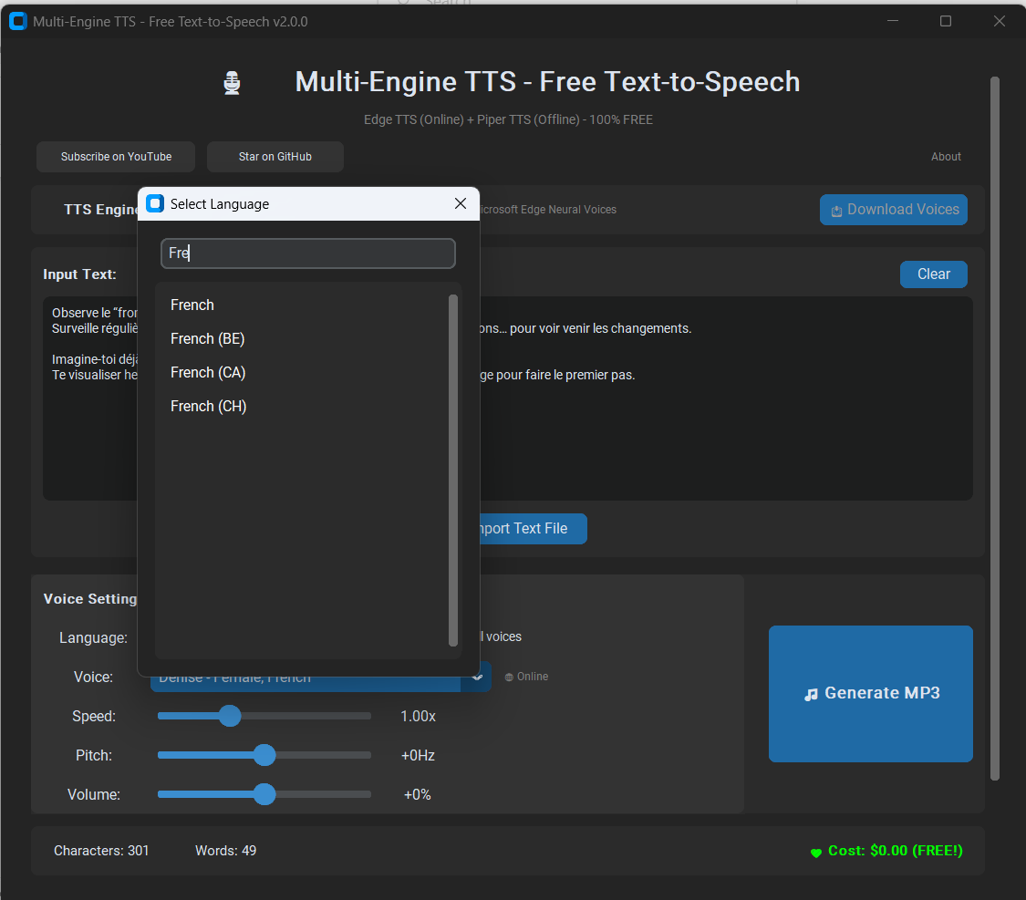
Edge TTS - Step 4
Now we got French language filtered
Let us select French (CA)

Slide 6
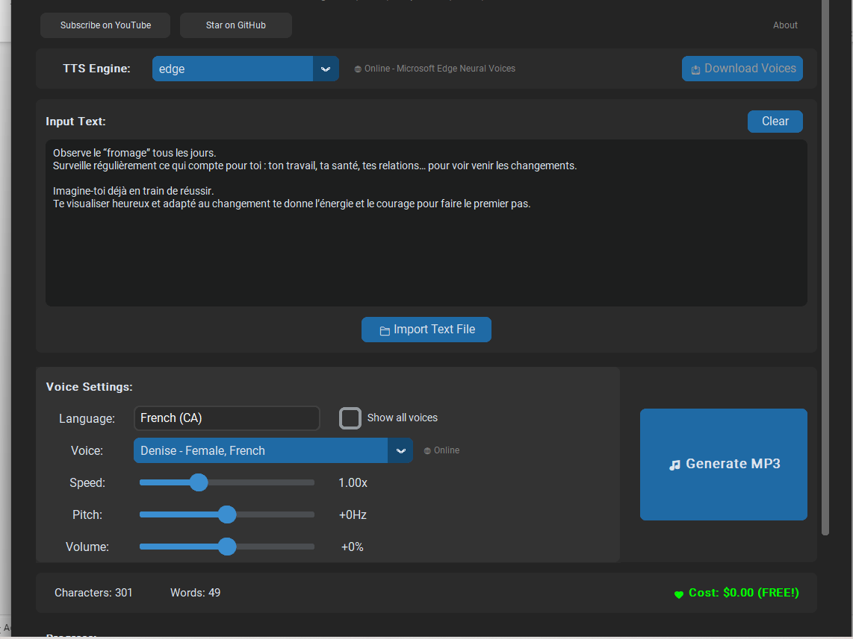
Edge TTS - Step 5
Then select the voice from the dropdown list
and proceed with Generate MP3

Slide 7
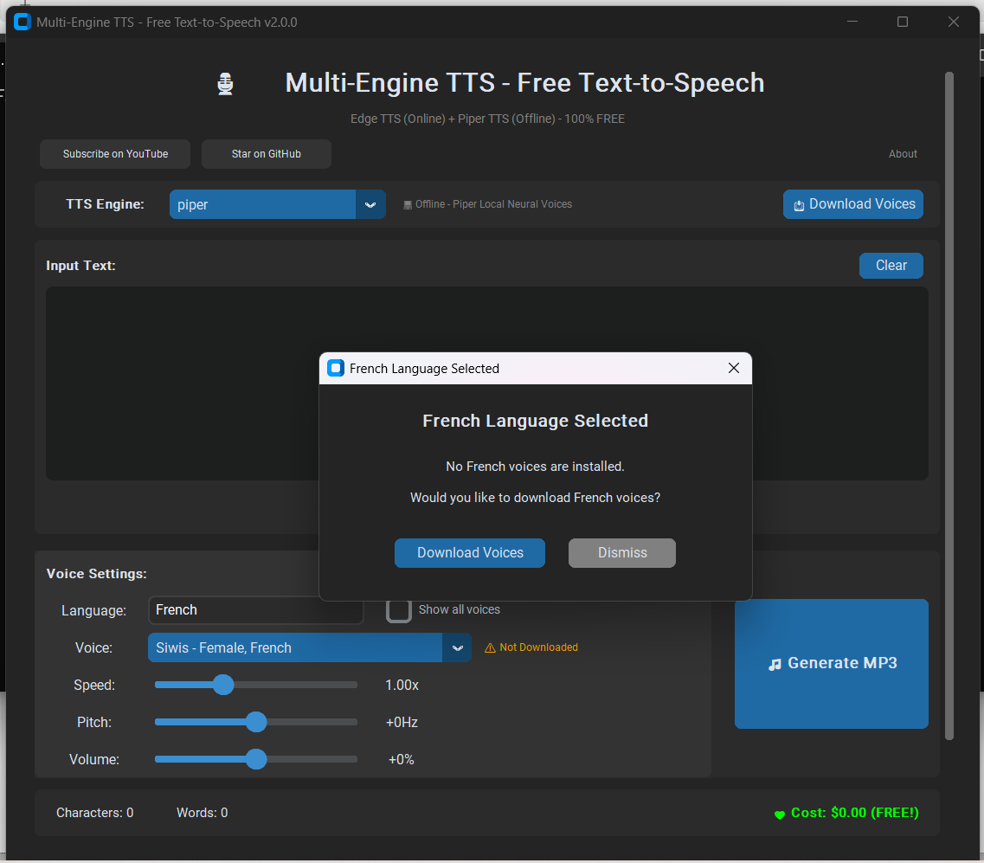
Piper TTS - Step 1
When you select language, if voices are not available, this screen will appear asking you to download

Slide 8
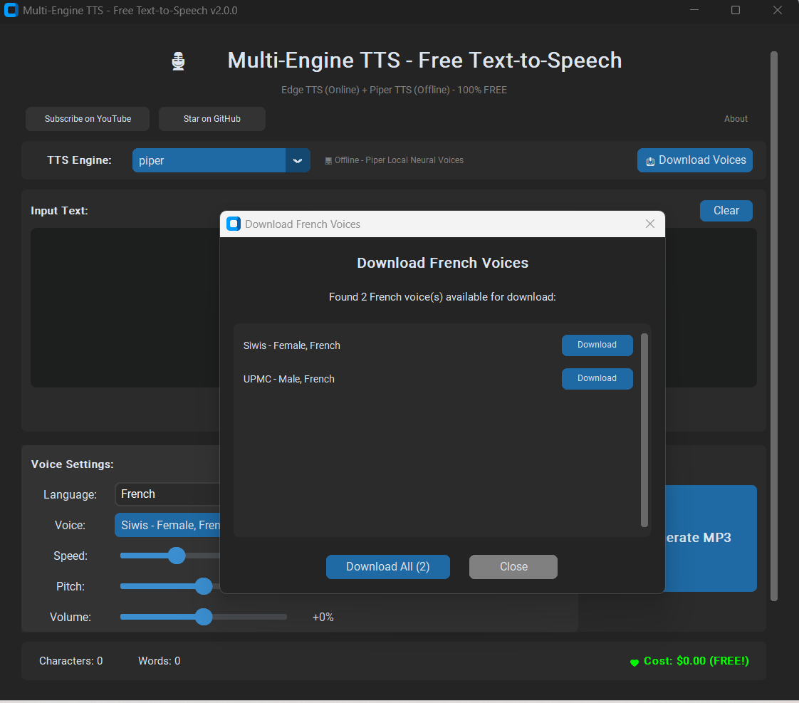
Piper TTS - Step 2
When you click Download voices on the previous screen, you will land here, click one by one or Download All to download voices

Slide 9
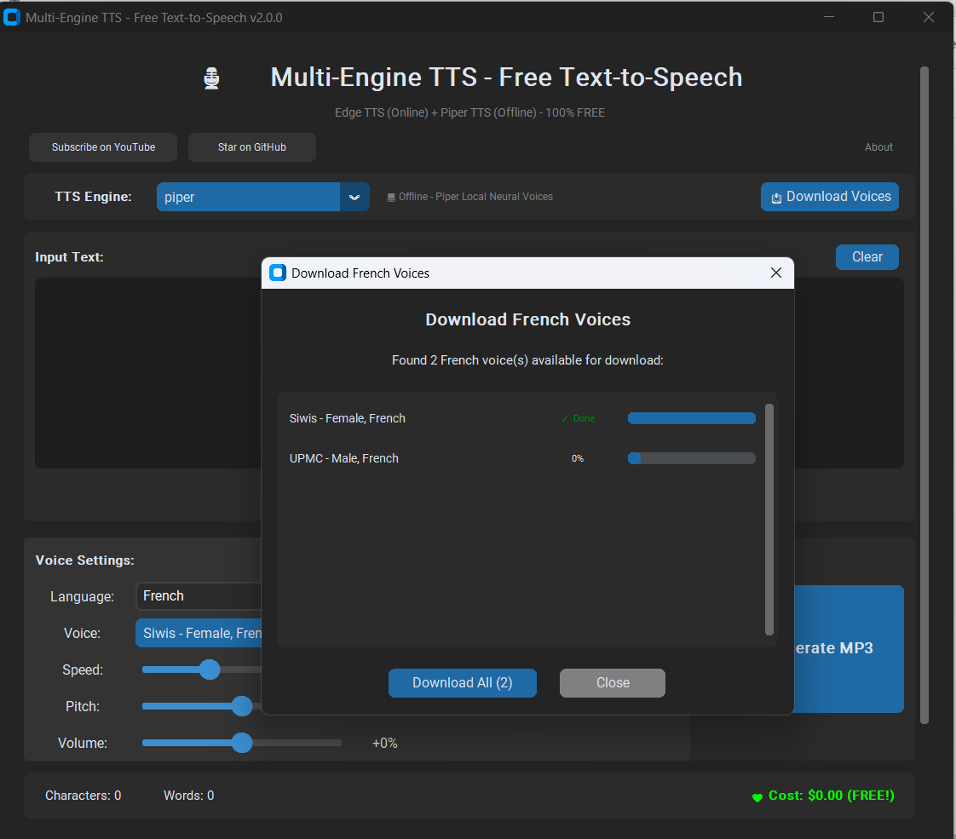
Piper TTS - Step 3
Once both are downloaded close this Popup

Slide 10
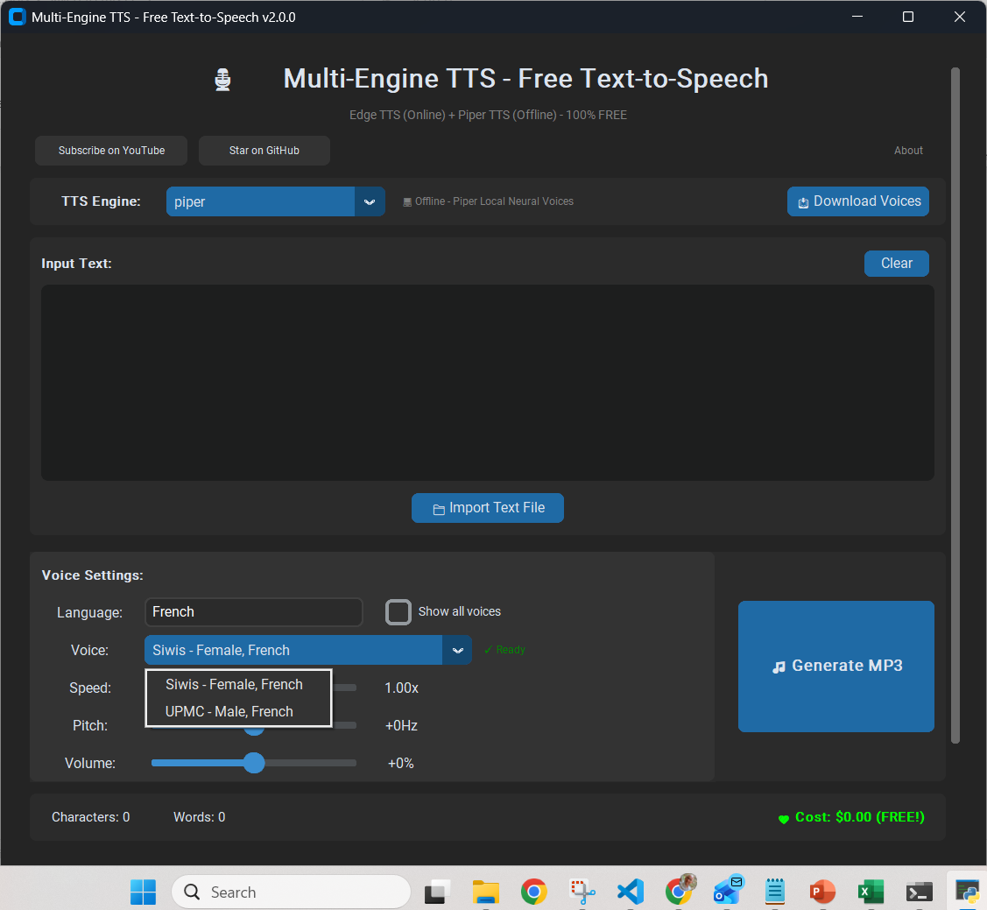
Piper TTS - Step 4
Now Select the voice and Generate Wav file

